Slide 1

OJT Report
Trainer: Ishihara-san
Trainee: Vu Tien Luan
2015B |  |  |  |  |  | 2016A |  |  |  |  |  | 2016B |  |  |  |  |  |  | 2017A
Oct | Nov | Dec | Jan | Feb | Mar | Apr | May | Jun | Jul | Aug | Sep | Oct | Nov | Dec | Jan | Feb | Mar | Apr | Apr | May | Jun | Jul | Aug | Sep
Training
 |  | HORN
 |  |  |  | TS FPGA
 |  |  |  |  |  | FPGA R&D
 |  |  |  |  |  |  |  |  | H.265
 |  |  |  |  |  |  |  |  | AMBASSADOR
 |  |  |  |  |  |  |  |  |  |  |  |  | HRCP
 |  |  |  |  |  |  |  |  |  |  |  |  |  |  |  | Renesas

Slide 2


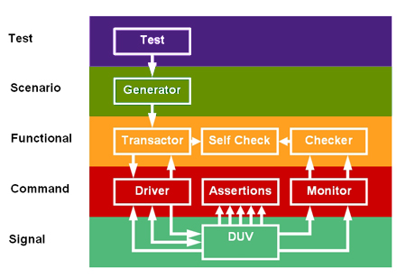
HORN Verification
What I have Done
Perl Scripting:
Spyglass report processing
Create image for test pattern
Verification Environment Investigation
Create test image vector
What I have Acquired
Verification Environment Components
Basic Perl
Verilog coding skill
What I need to Learn
Fundamental of Digital Image Processing
Perl
C Shell

Slide 3
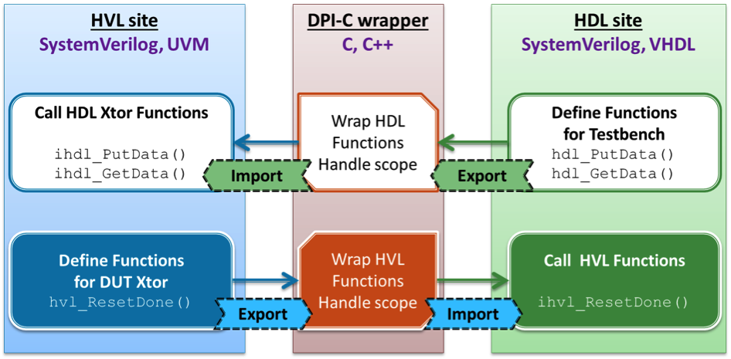
DCDC Controller
What I have Done
Duty Calculation: porting C software model to Verilog module
Verilog module verification:
(1) Direct test derived from Software Test Specification
(2) Using SystemVerilog DPI-C
Capture module: RTL coding
What I have Acquired
Data dependency: from SW to HW
SystemVerilog DPI-C API, Assertion API

Slide 4
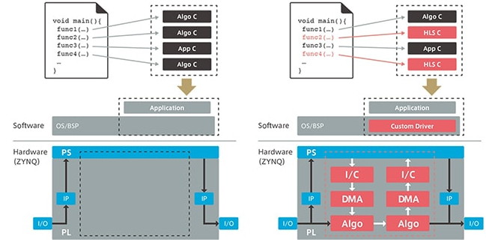
FPGA R&D
What I have Done
What I have Acquired
High Level Synthesis Evaluation:
Xilinx platform: SDSoC, Zynq
FocusNavi SW: tunning target Zynq
Speedup evaluation: SW to HW
Basic of High Level Synthesis
Write/tune efficient C code target for HLS on Xilinx platform

Slide 5

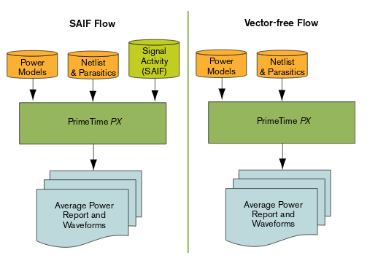
HEVC Power Optimization
What I have Done
SystemC tuning (reduce bit-width) TME module
Synthesis:
SystemC to Verilog
Verilog to Gate-Level Netlist
SystemC/Verilog/Gate Simulation
Power Estimation and Report
What I have Acquired
Basic SystemC and HLS flow
Power model estimation
Static analysis
Dynamic analysis
EDA tools hand-on: Cynthesizer
Design Compiler, PrimeTime

